Slide 1
網站框架開發助理證書 (CT290DS008) - ERB8
Title: Django Web Framework on Catering Order Platform
An introduction of high level High-Level Python Web Development
Team Member
Wong Chi Hung (5)
Leung Kwun Chiu Jackie (18)
Wong Kwok Bun 黃國斌 (7)
Ho Chak Kong ‘ Ricky (19)
Loo Kin Wah, 盧建華 (6)
Date : 2026.Jan.29

Slide 2
Table of Content
Project Introduction
WebSite Architecture Diagram
WebSite Page Functionality Overview
Screenshot Showcase
Team Divisions & Reflections
WebSite Demo
Q&A Session

Slide 3
Project Introduction
Development Motivation: Why choose an e-commerce platform? Market needs, learning objectives, etc.
Learning and Practice Objectives
Implement skill from learning
Challenges Faced:
Technical difficulties(database design, user authentication, shopping cart logic)
Team collaboration difficulties
Solutions Implemented:
Apply different technical solutions.(e.g teamwork strategies, web , book resources referenced)
Reflections: Learning outcomes.
Technical growth;
Teamwork experience;
Project management

Slide 4
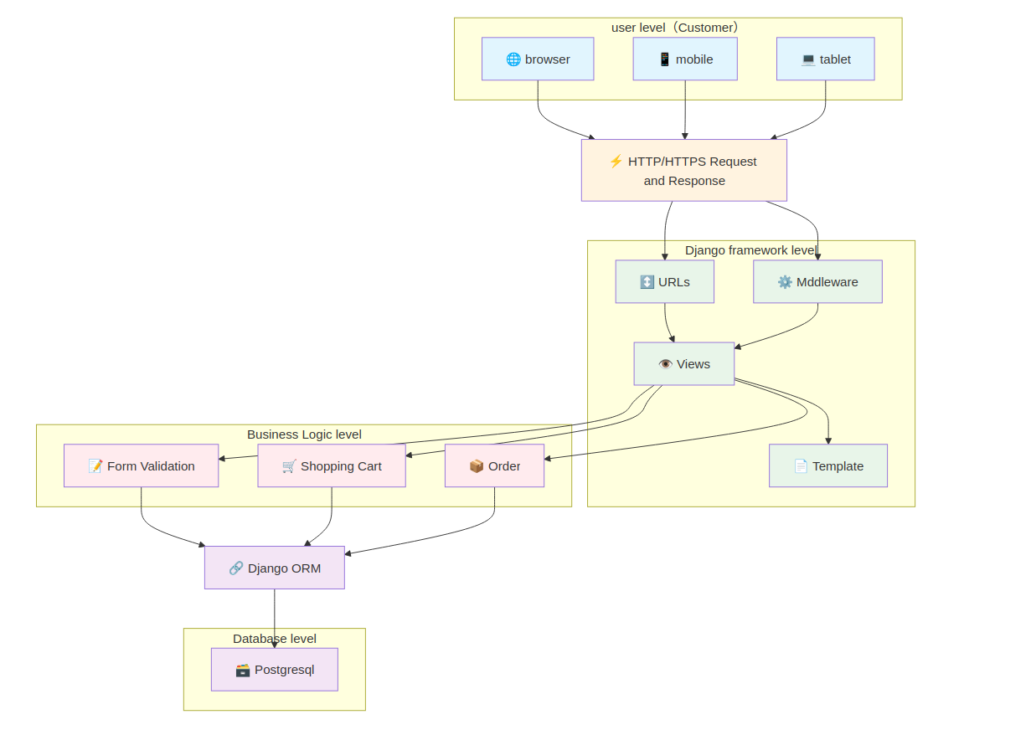
WebSite Architecture Diagram
Overall Architecture Diagram :
Frontend: HTML/CSS/JavaScript + Bootstrap
Backend: Django (MVT Architecture)
Database: PostgreSQL
Deployment Environment (e.g.local development setup)

Slide 5
Advantage of using Django
Structure of Django … (MVT)
Core component - Admin, ORM, URL Dispatcher
Philosophy: "Batteries-Included" (comes with built-in tools for auth, admin, and databases)
Fast: Move from concept to launch quickly.
Secure: Helps developers avoid common mistakes like SQL injection or Cross-site scripting (XSS).
Scalable: Used by giants like Instagram, Pinterest, and Disqus.
Community: Huge library of third-party "packages" to add features instantly.

Slide 6
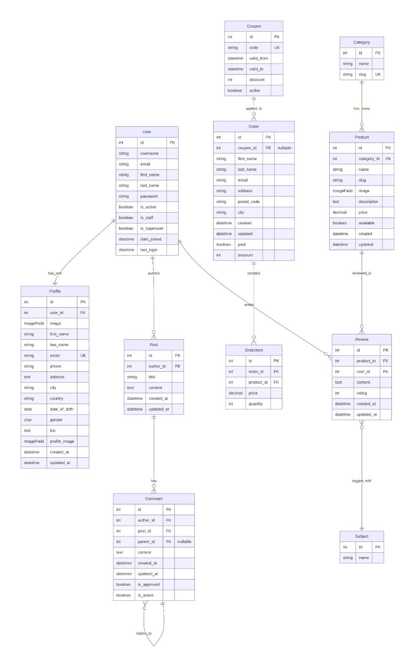
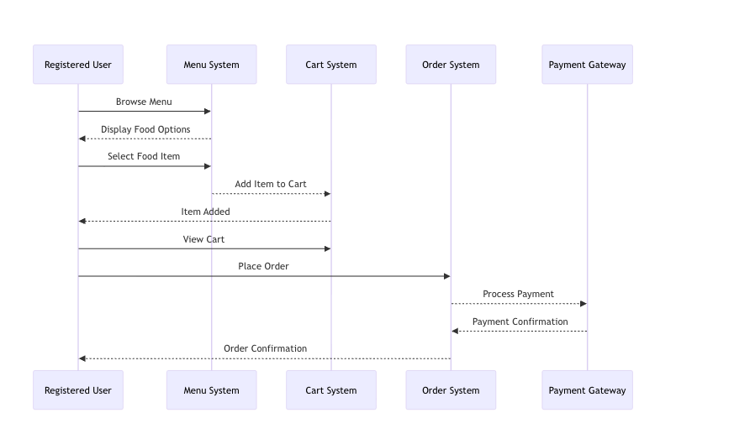
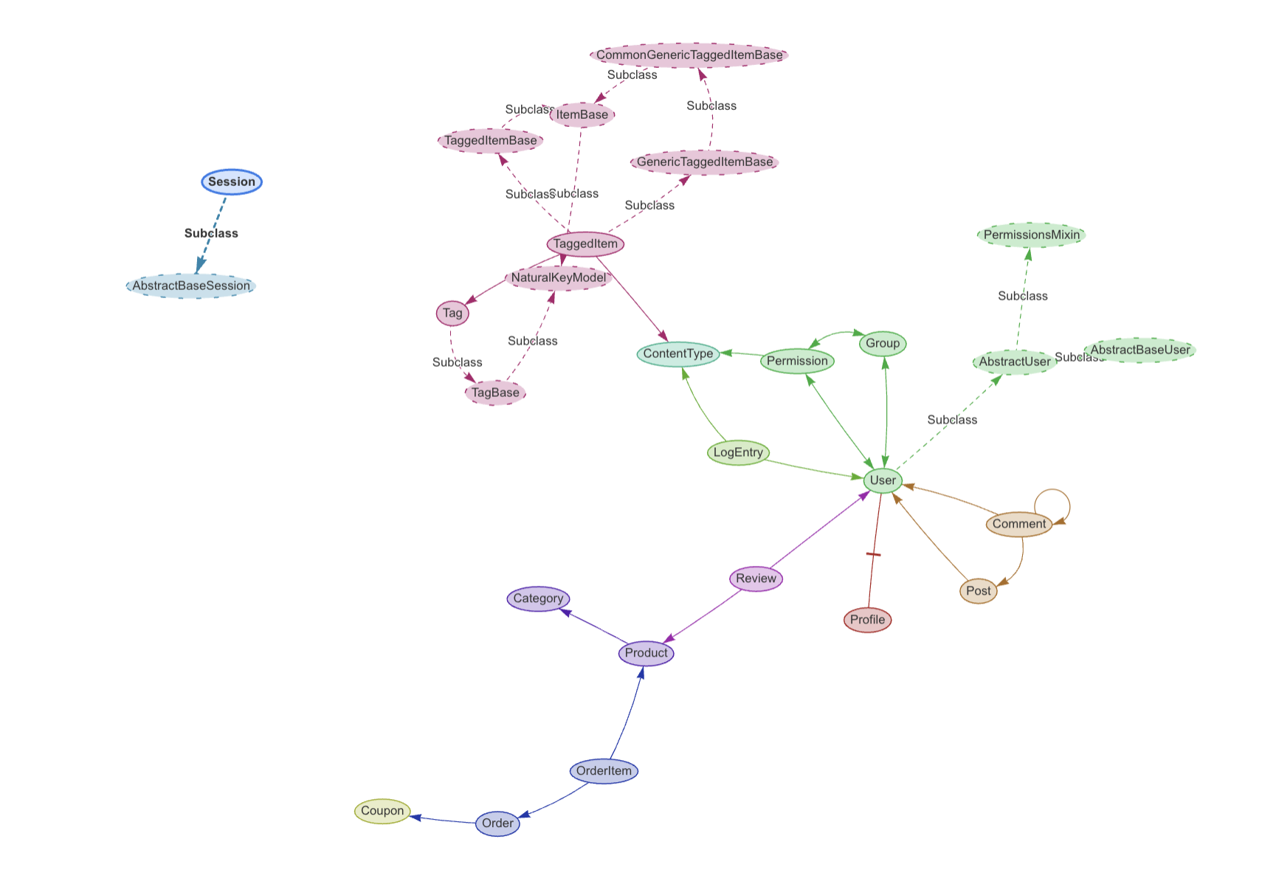
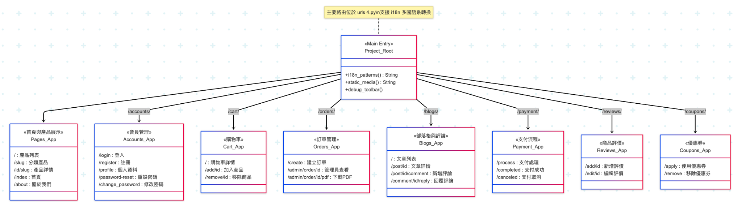
Website Structure

Slide 7
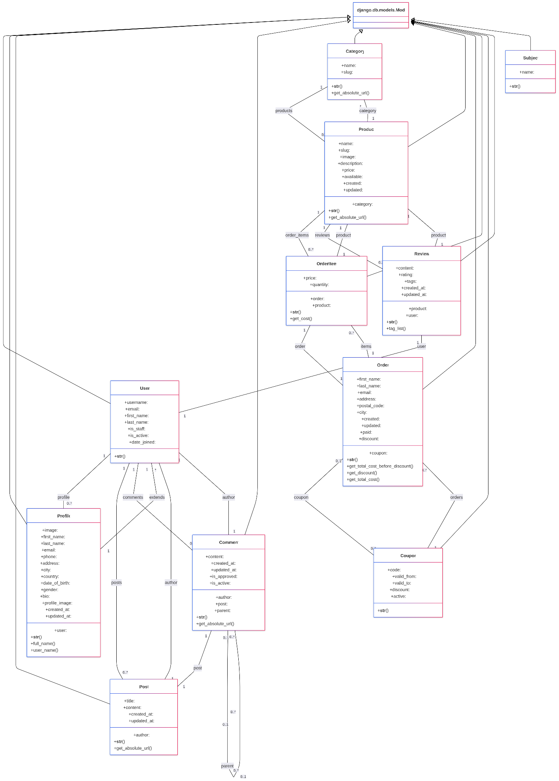
Class Diagram

Slide 8
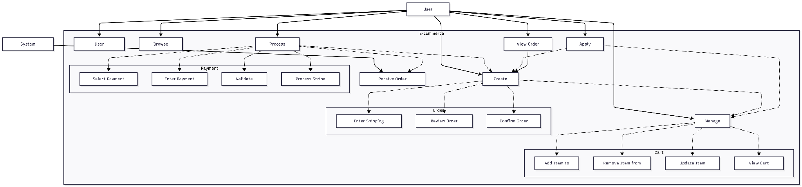
Purchase process UML Diagram

Slide 9
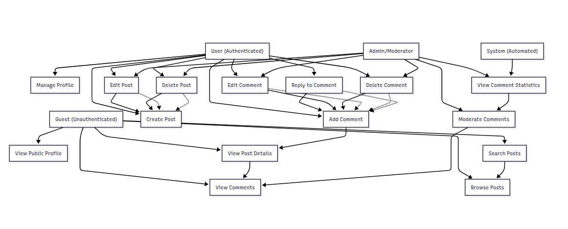
Blog Post Comment UML Diagram

Slide 10
WebSite Page Functionality Overview
Homepage: Product display, search bar, navigation menu
User Registration/Login/Logout Pages: Django built-in auth system + custom styling
Product Listing Page: Category display, pagination
Product Detail Page: Product information, "Add to Cart" button,Product Review
Shopping Cart Page: Product management (CRUD), price calculation
Checkout Page: Order confirmation, payment information (simulated)
Payment Page: User input email and credit card number,Pay” button
Payment succeed Page : Confirmation email sent to user
Admin/Management Page (Django Admin or custom-built): Product ,Category ,Review,Post ,Comment & order management
About Us Page: Static content
User Profile : Edit user Profile
Post and comment feature : Auth user create post and comment (CRUD)
Responsive Design Demo: Display on mobile, tablet, and desktop

Slide 11
Website Pages Functions
Core Experience | E-Commerce Flow | Social & Admin
Homepage: Global Search & Nav | Cart: Price Calculation & CRUD | Social: Post & Comment System (CRUD)
Catalog: Categories & Pagination | Checkout: Payment, Order Confirm | User: Profiles & Django Auth
Product: Details & Statistic Reviews | Payment: Email & Credit Card Entry | Admin: Food Catalog, Social & Order Mgmt
About: Static content | Success: Email Confirmations | Responsive: Mobile interface

Slide 12
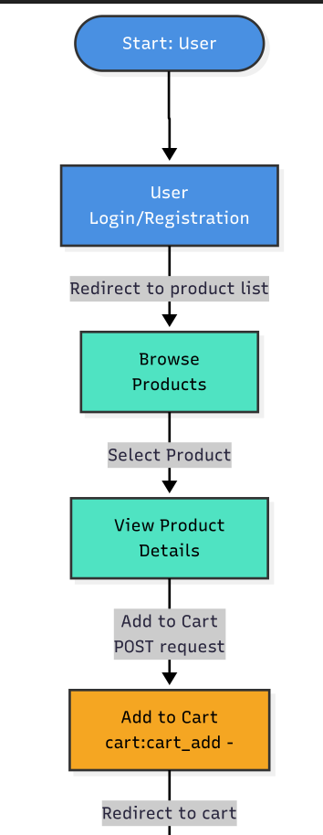
Add product to cart workflow
Homepage: Product display, search bar, navigation menu
User Login/Logout Pages: Django built-in auth system + custom styling
Product Listing Page: Category and Product display, pagination
Product Detail Page: Product information, "Add to Cart" button, Product review section

Slide 13
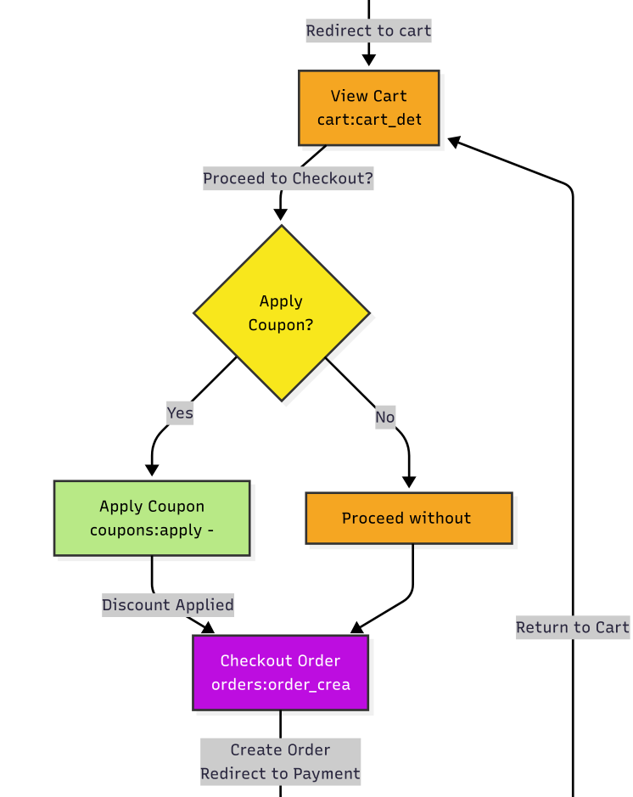
Shopping cart workflow
Shopping Cart Page: Product management (CRUD), price calculation,coupon usage
Checkout Page: Order information input ,Order preview and confirmation,

Slide 14
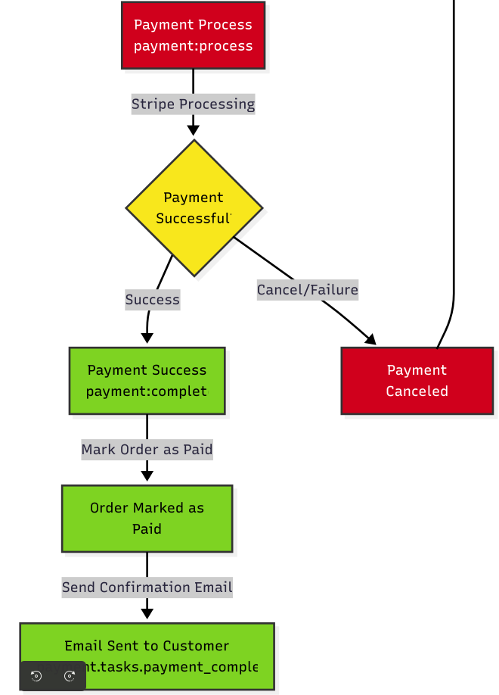
Payment workflow
Checkout Page: Order information input ,Order preview and confirmation,
Payment Page : Payment information (email, credit card information,total amount)( simulated)
Order succeed page: Confirmation email sent to user

Slide 15
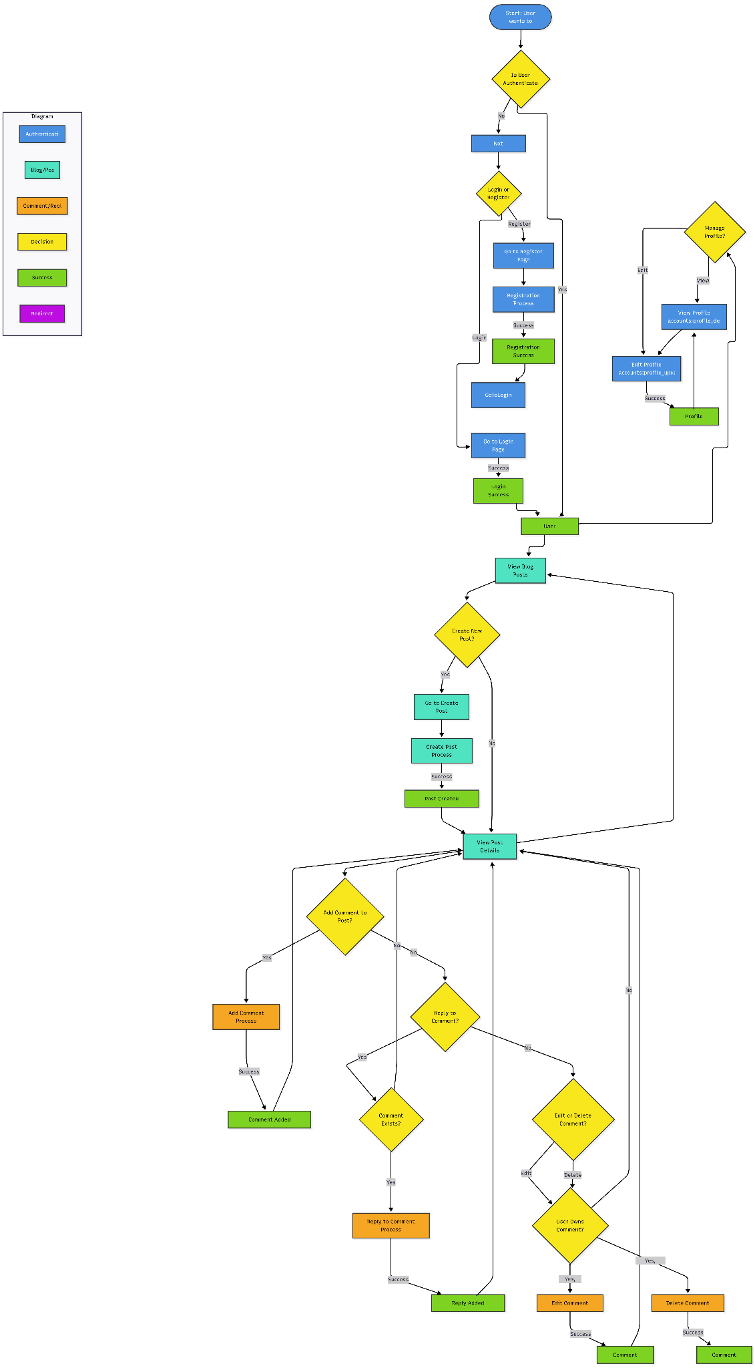
User Profile and Post workflow
User Registration/Login Pages: Django built-in auth system
User Profile : Edit user profile information
Post Section : Post feature (CRUD)
Comment and Reply Comment Section : Comment feature (CRUD)

Slide 16
Screenshots
Registration and login
Website -about
Dish selection
Shopping kart
Payment
Forgot password
Blog
Review
Backend management
Import/ Export dish database

Slide 17
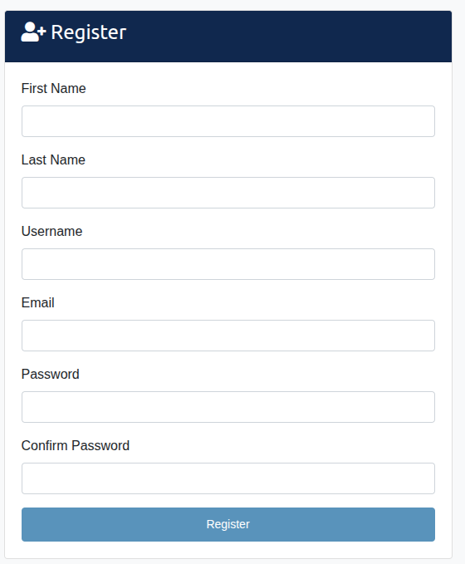
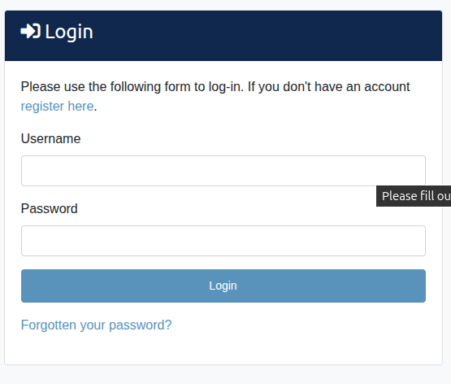
Registration and Login

Slide 18
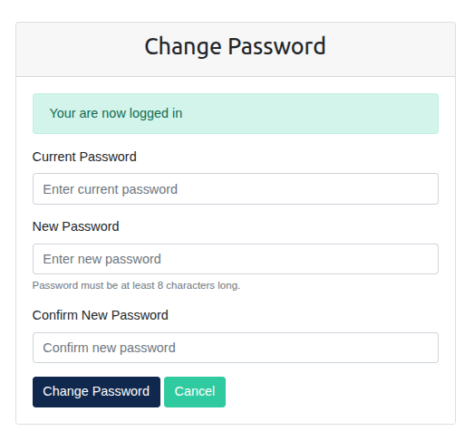
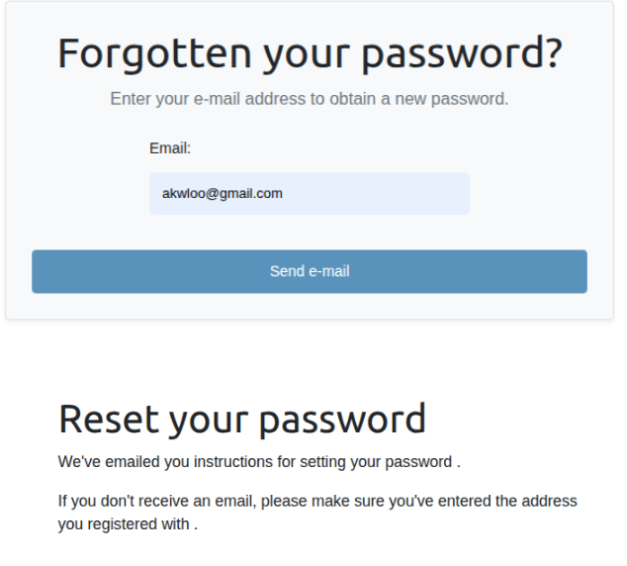
Change password and Forget password

Slide 19
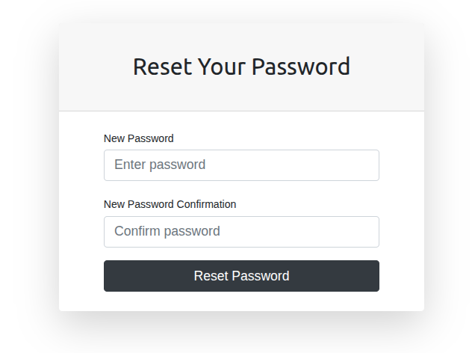
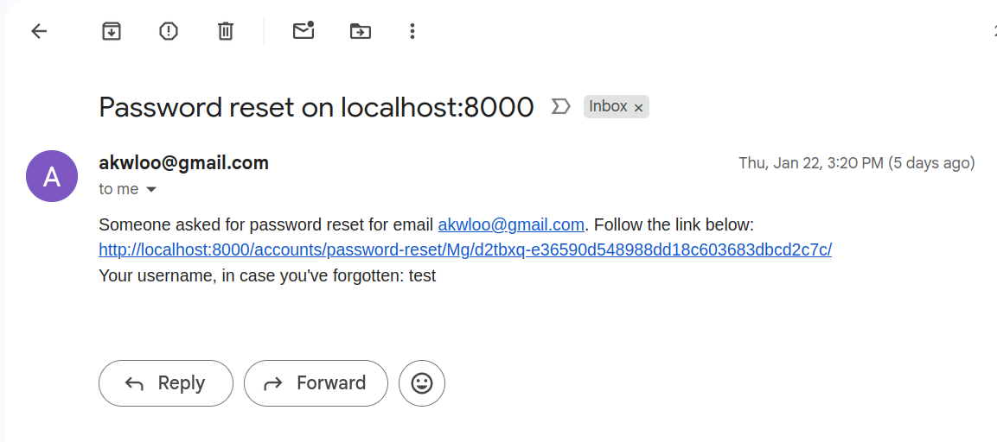

Slide 20
Reset password email

Slide 21
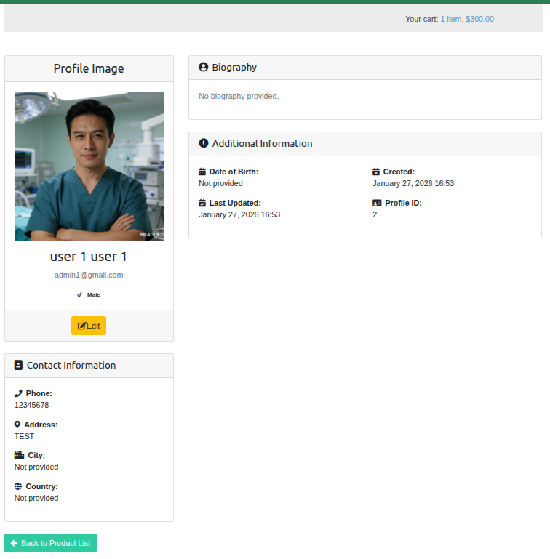
Profile

Slide 22
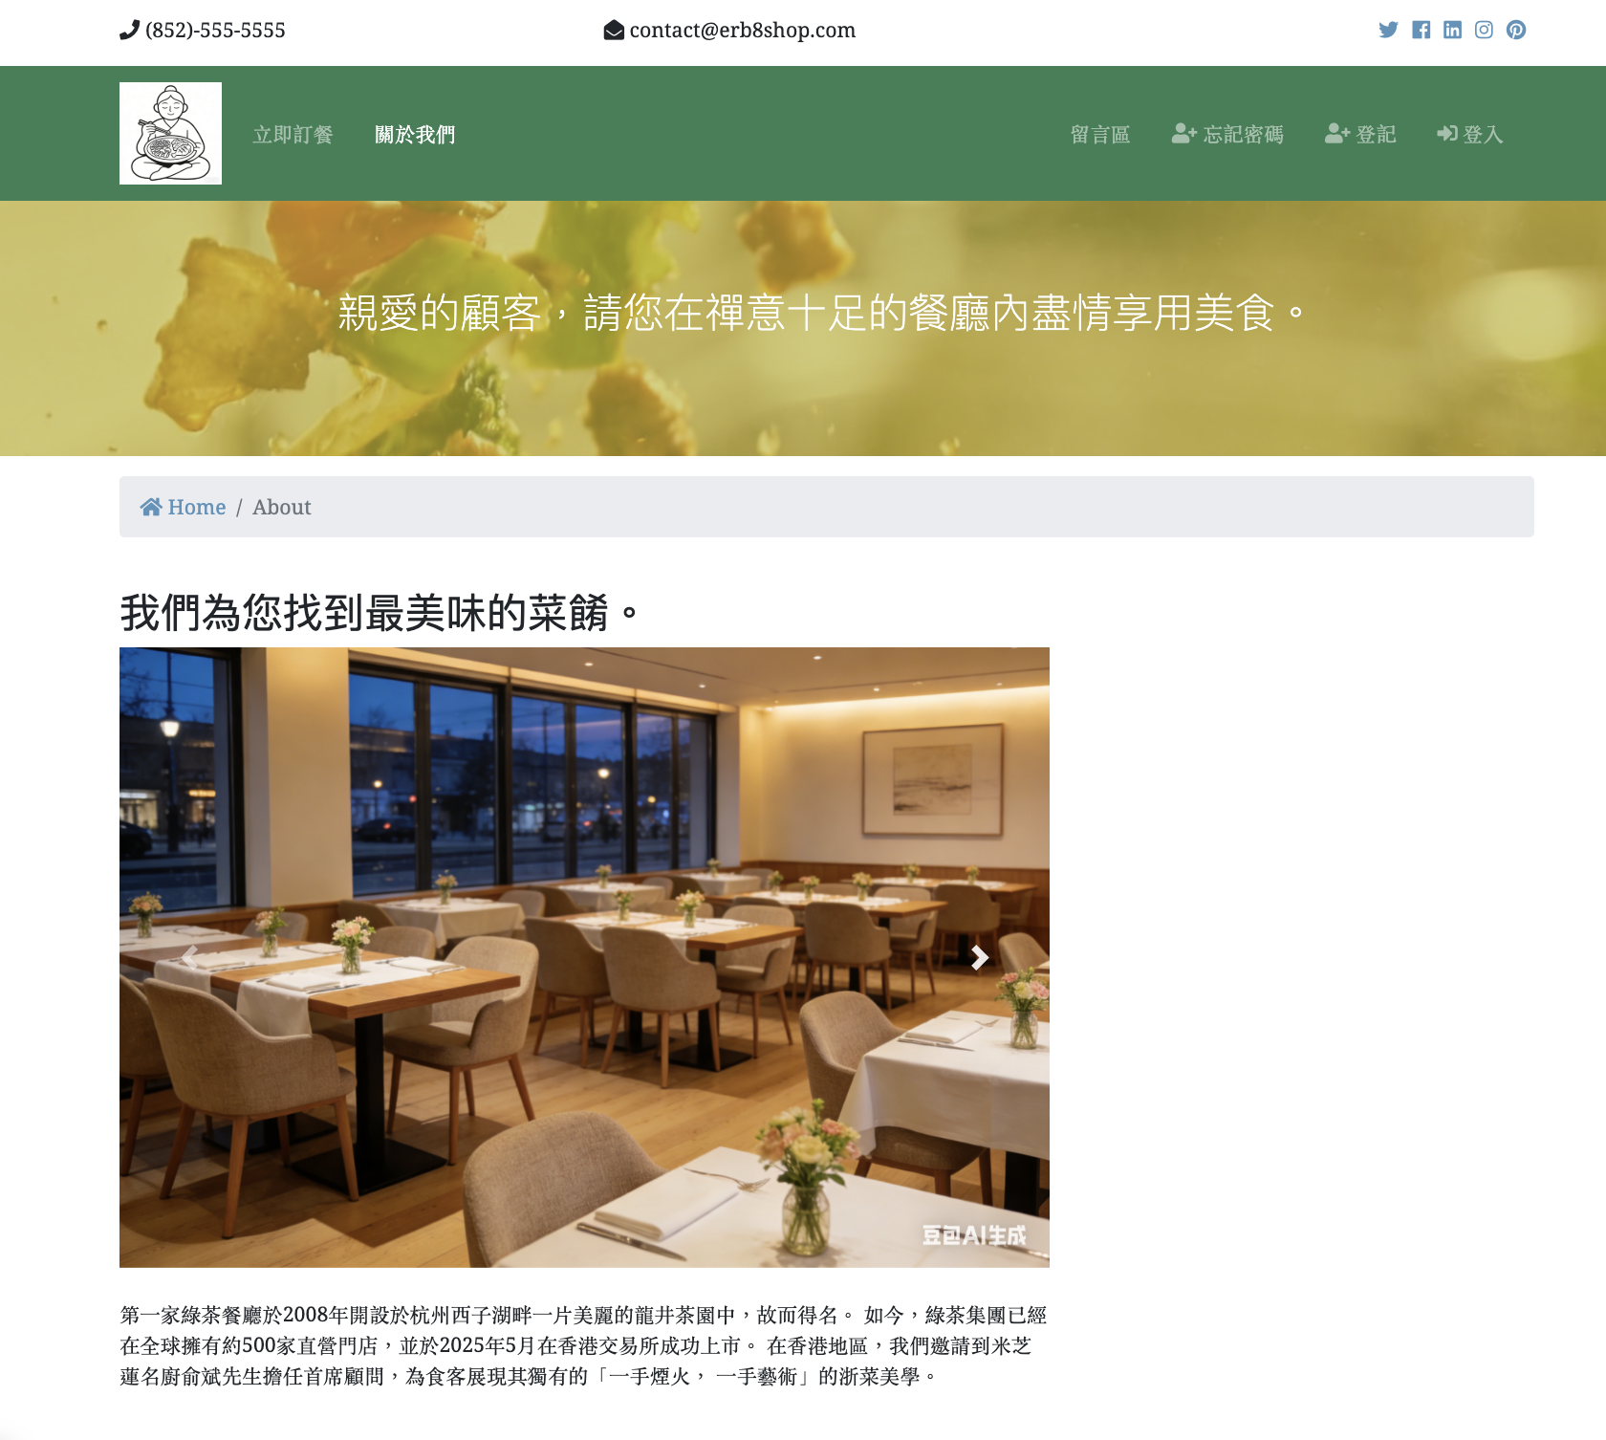
The restaurant information page (about)

Slide 23
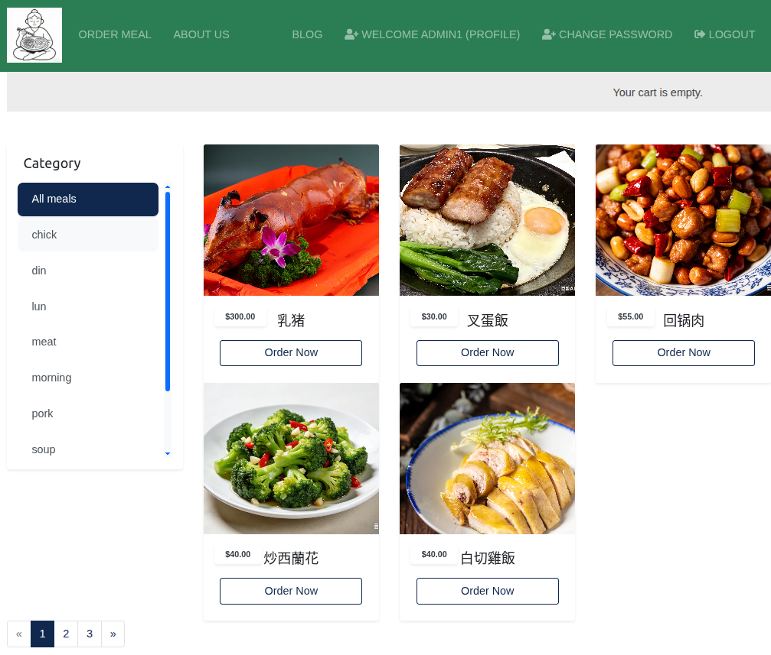
Product List

Slide 24
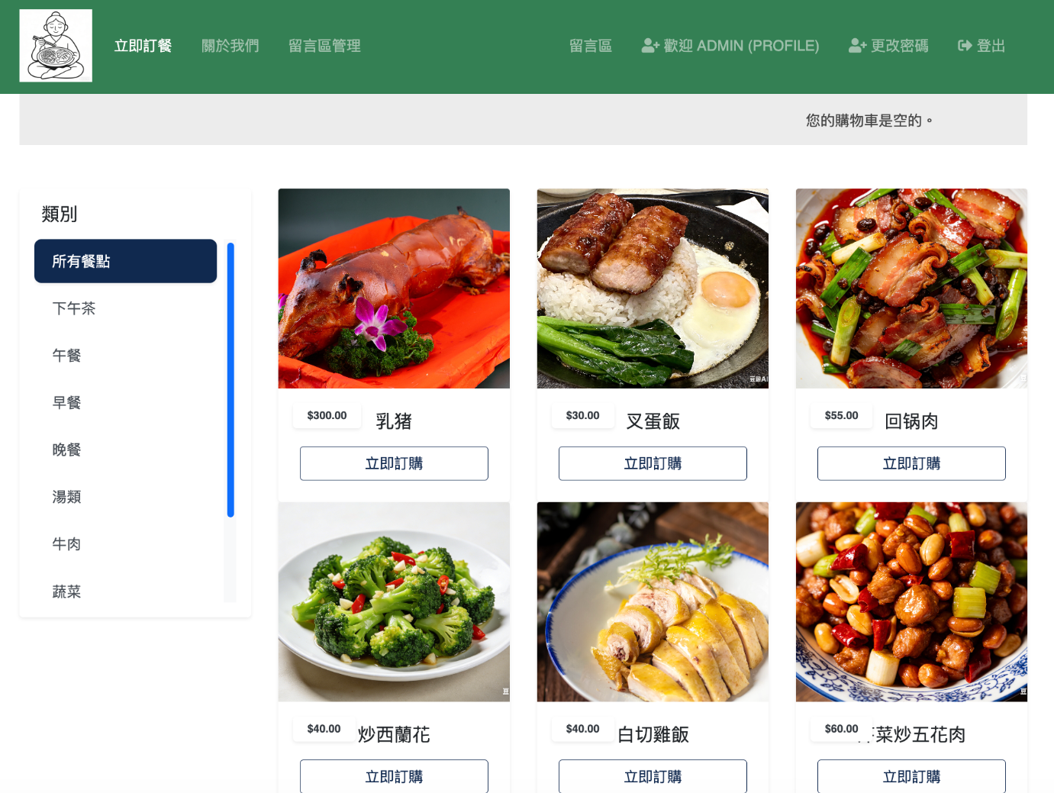
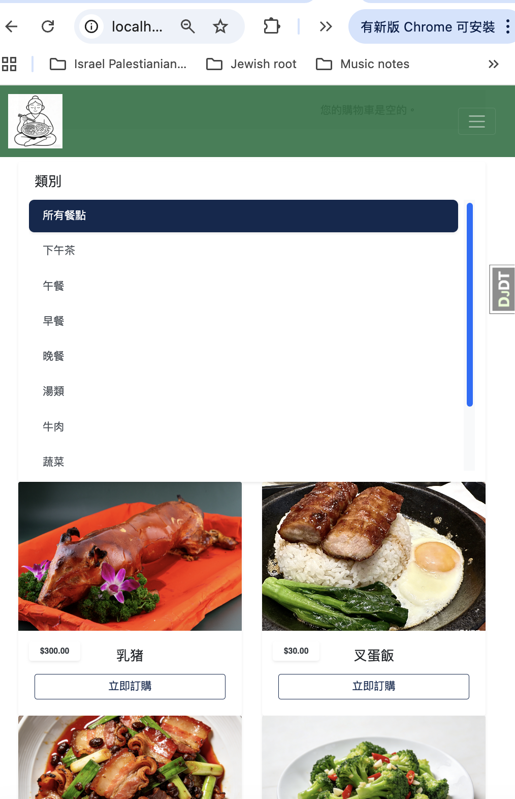
Auto adjustment to different screen size

Slide 25
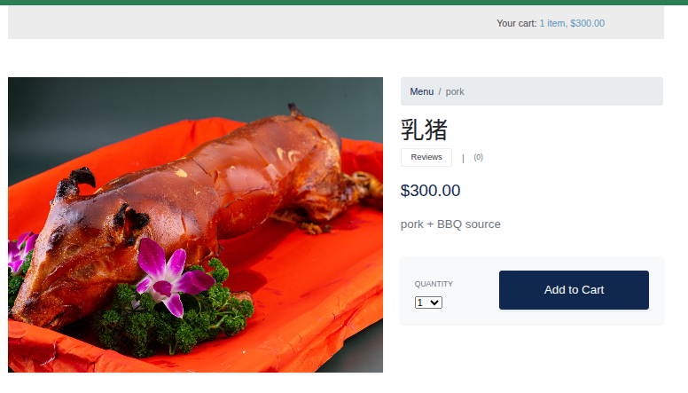
Product Detail

Slide 26
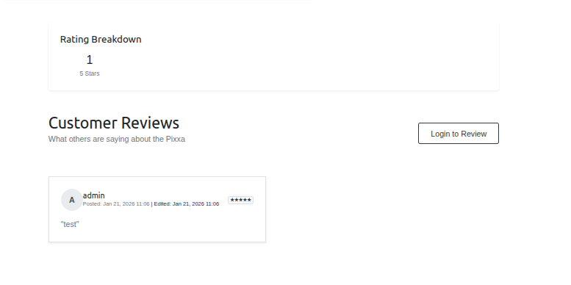
Product Detail Review

Slide 27
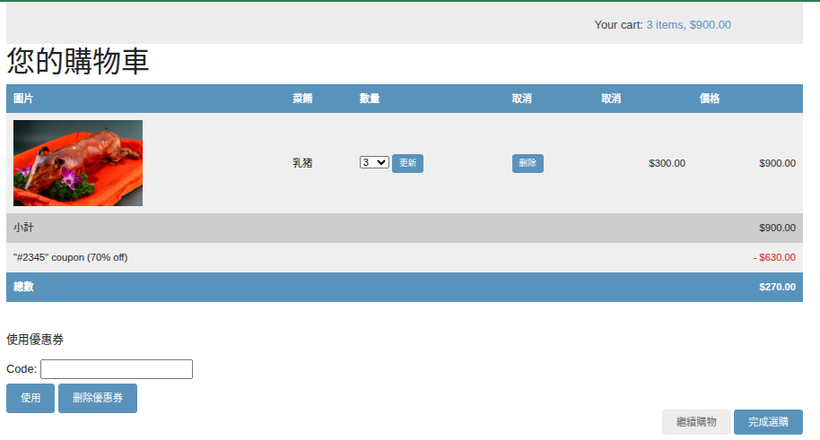
Shopping Cart

Slide 28
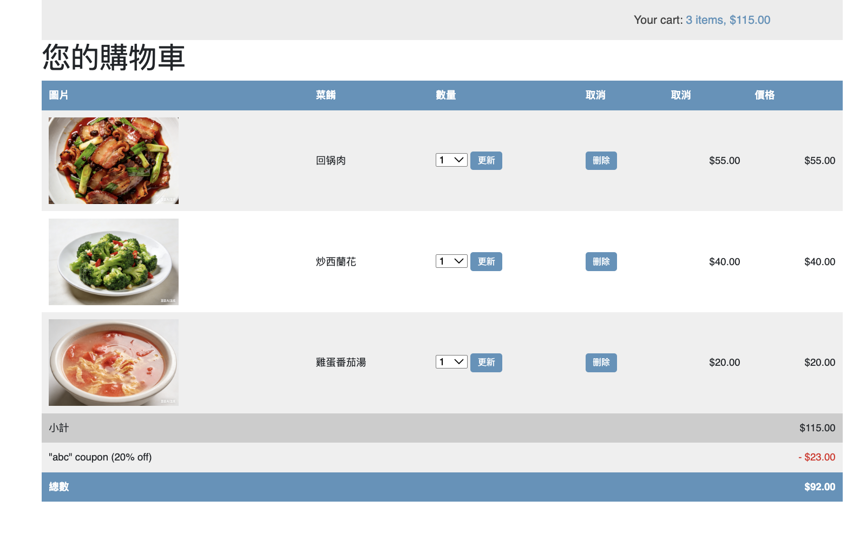
Multiple selection

Slide 29
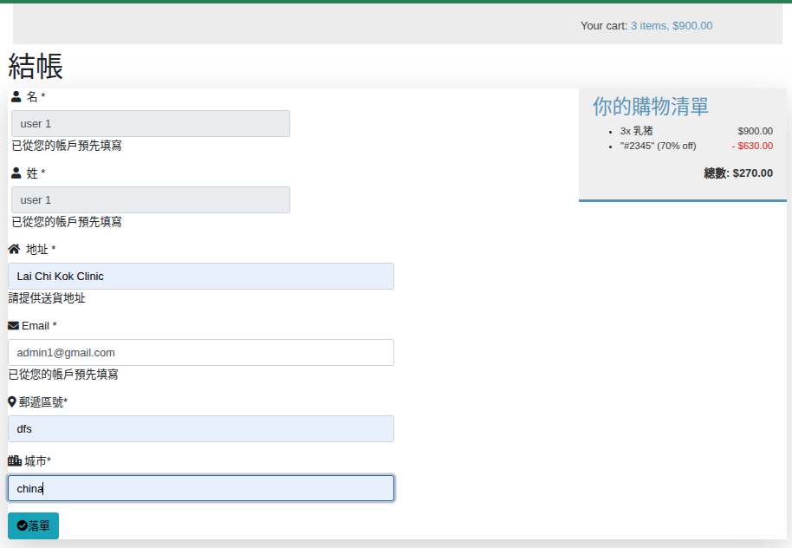
Delivery details and purchase summary

Slide 30
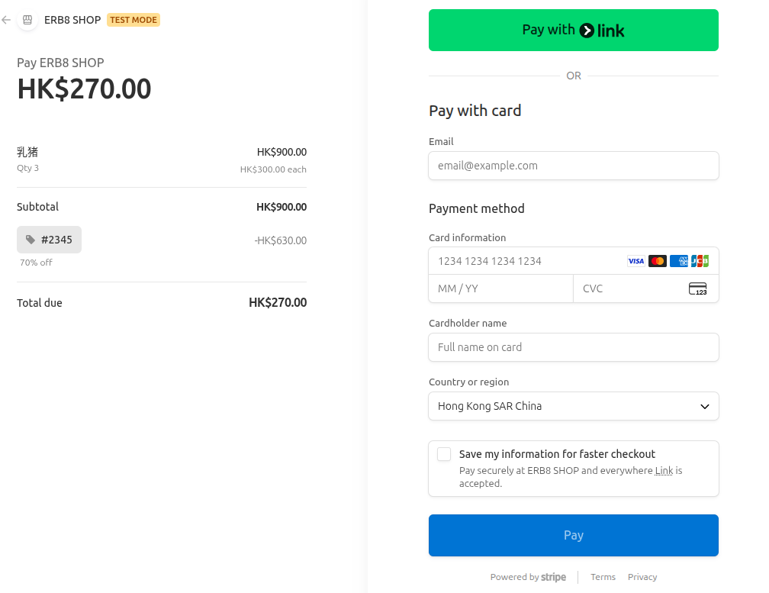
Payment

Slide 31
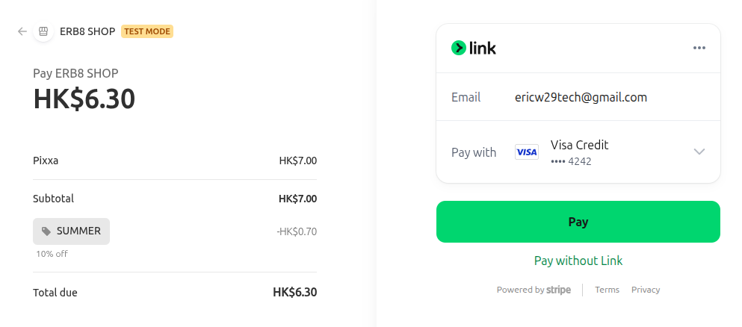
Payment - connect to visa card

Slide 32
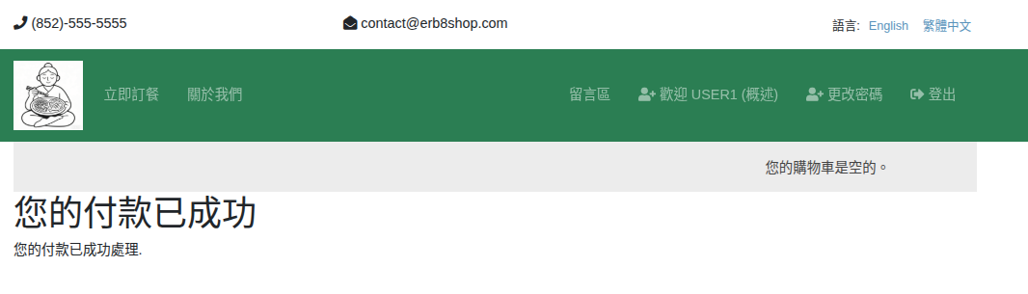
Payment Success

Slide 33
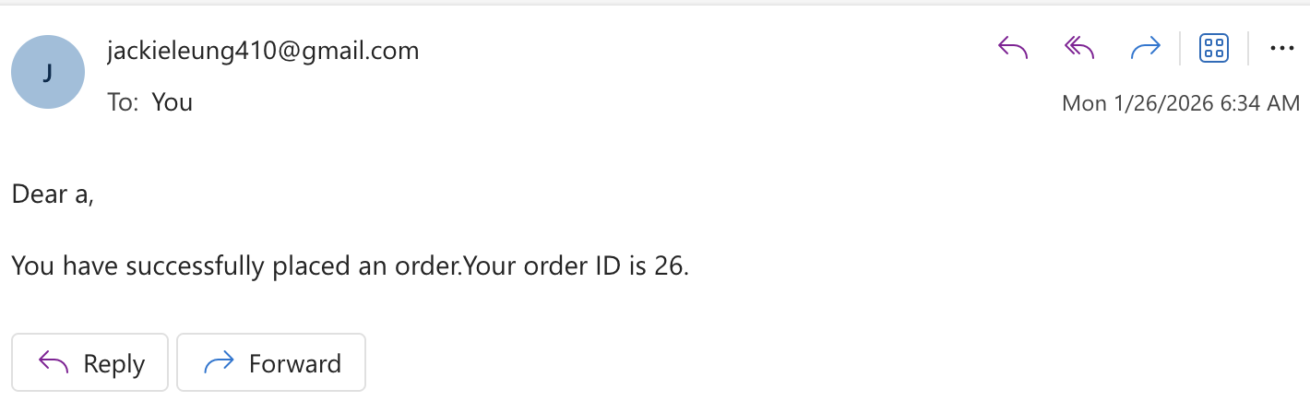
Email is sent to the buyer for comfirmation

Slide 34
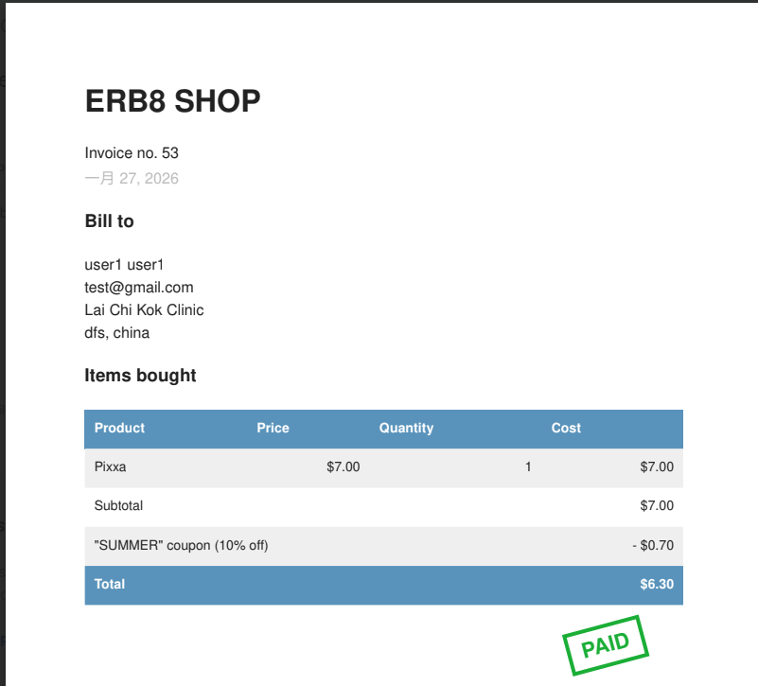
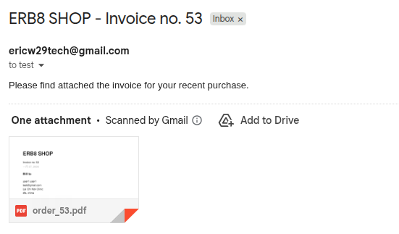
Confirmation email

Slide 35
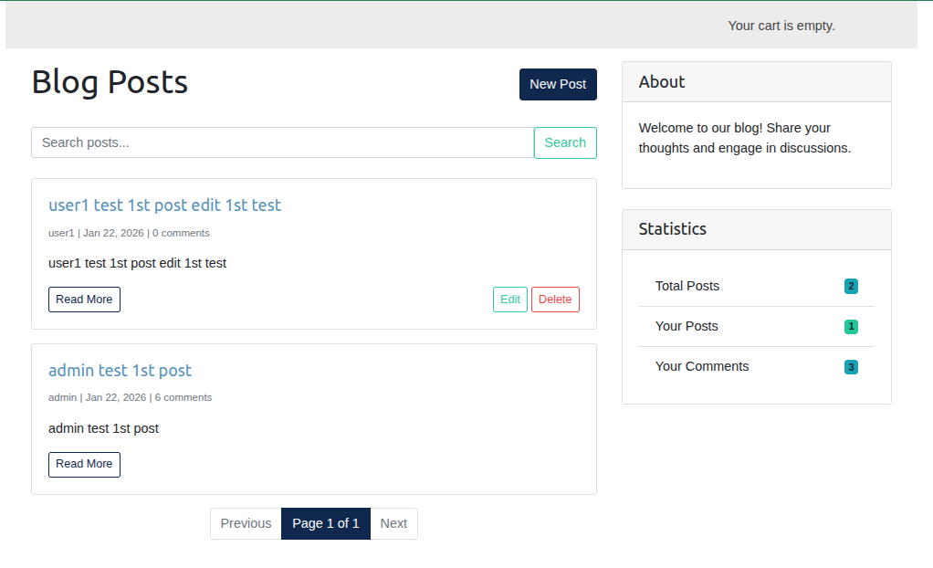
Other Feature - Blog

Slide 36
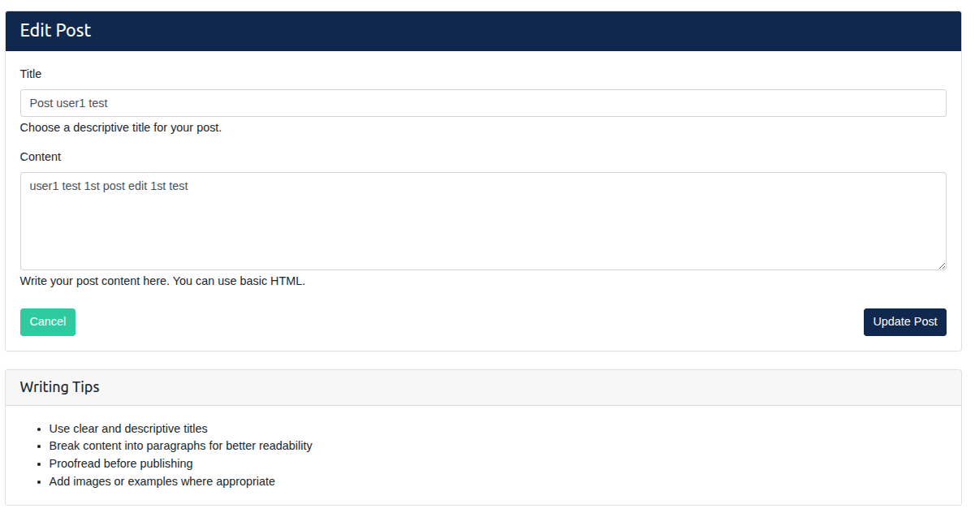
Other Feature - Blog(Edit)

Slide 37
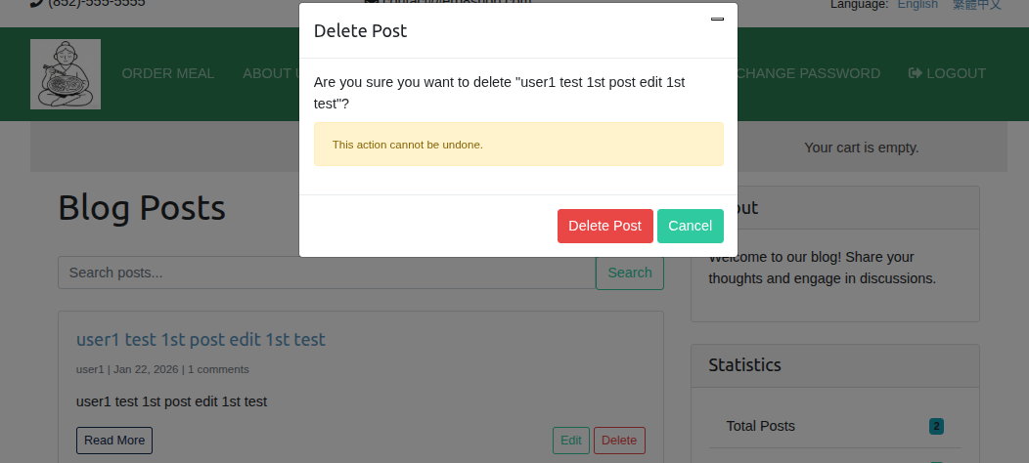
Other Feature - Blog(Delete)

Slide 38
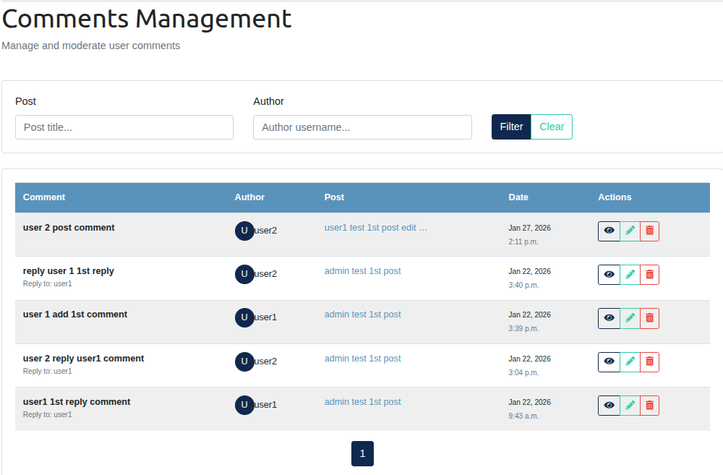
Other Feature - Comment Management

Slide 39
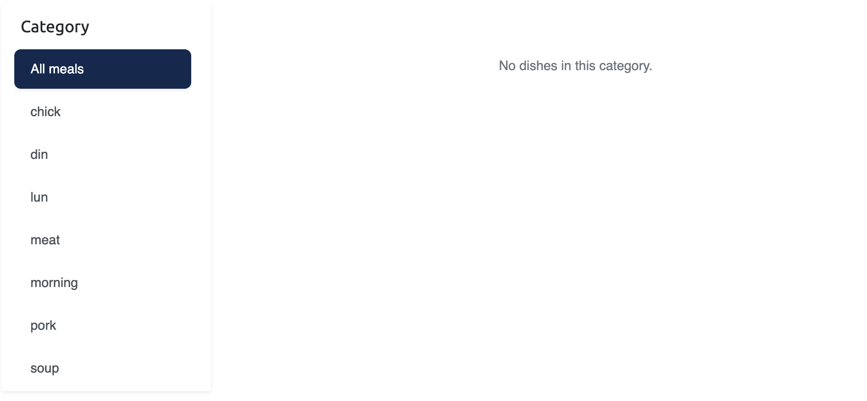
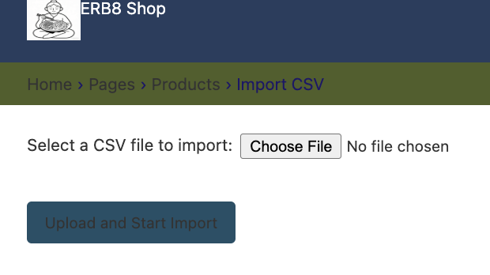
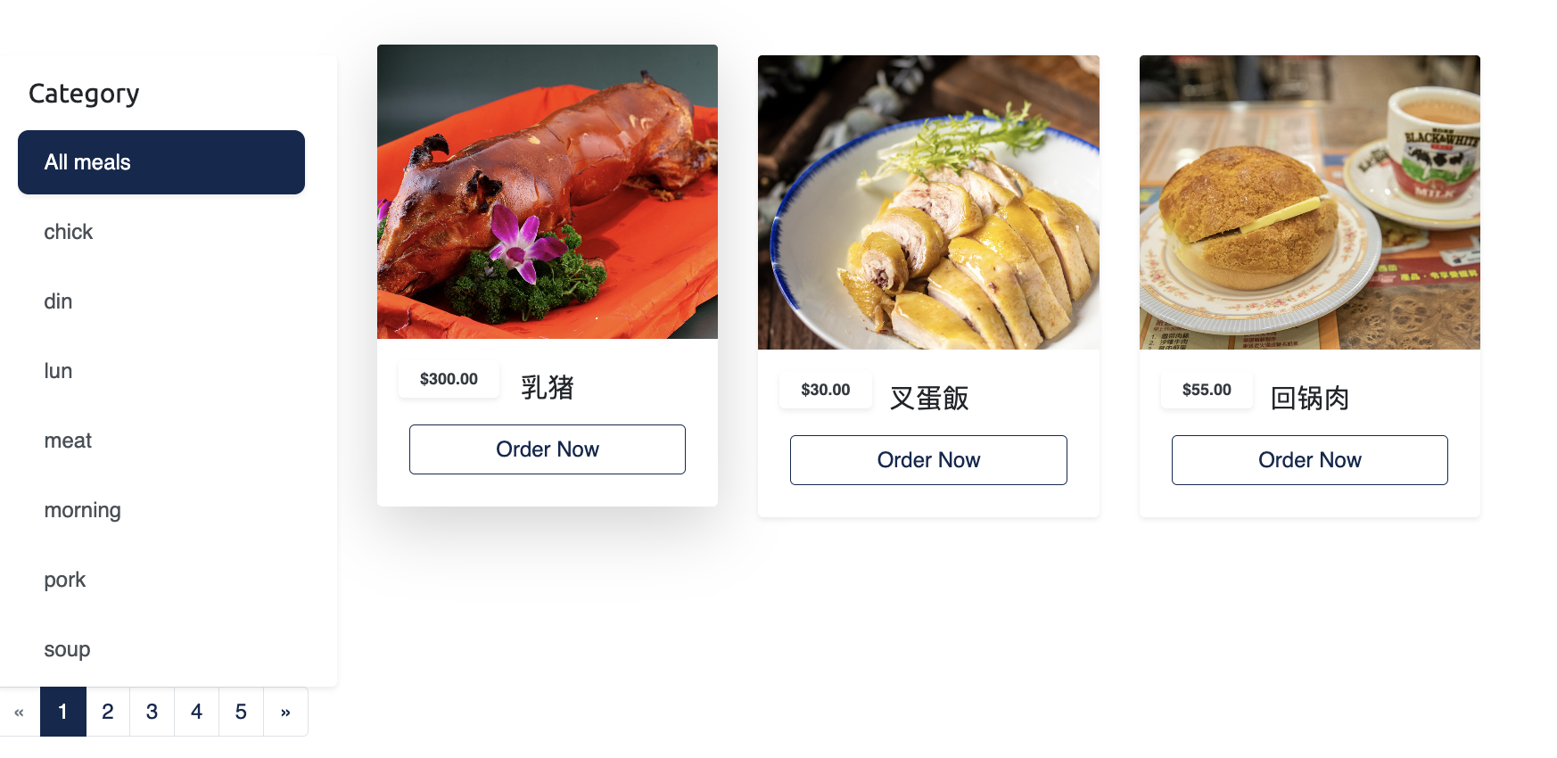
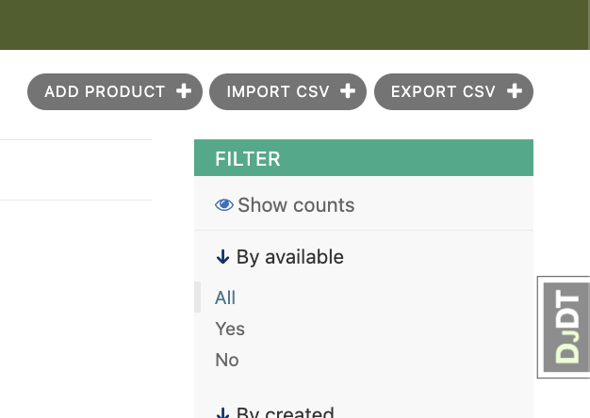
Other Feature - Import csv meau with Photos

Slide 40
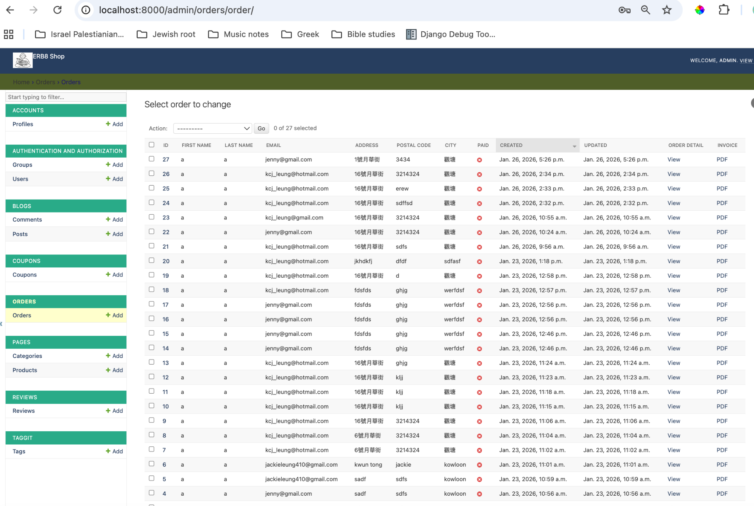
Order history

Slide 41
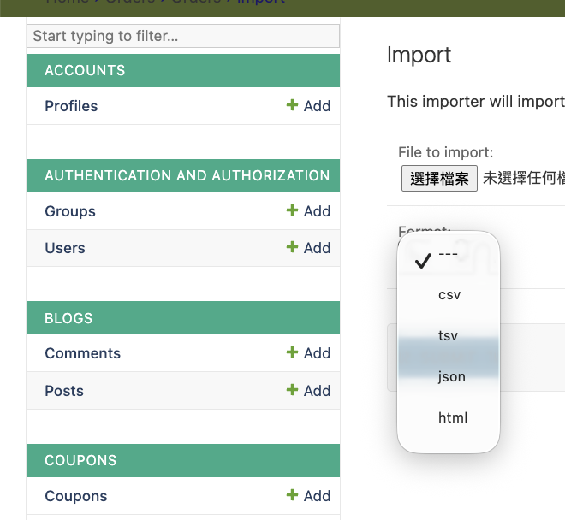
Import dish database to different format

Slide 42
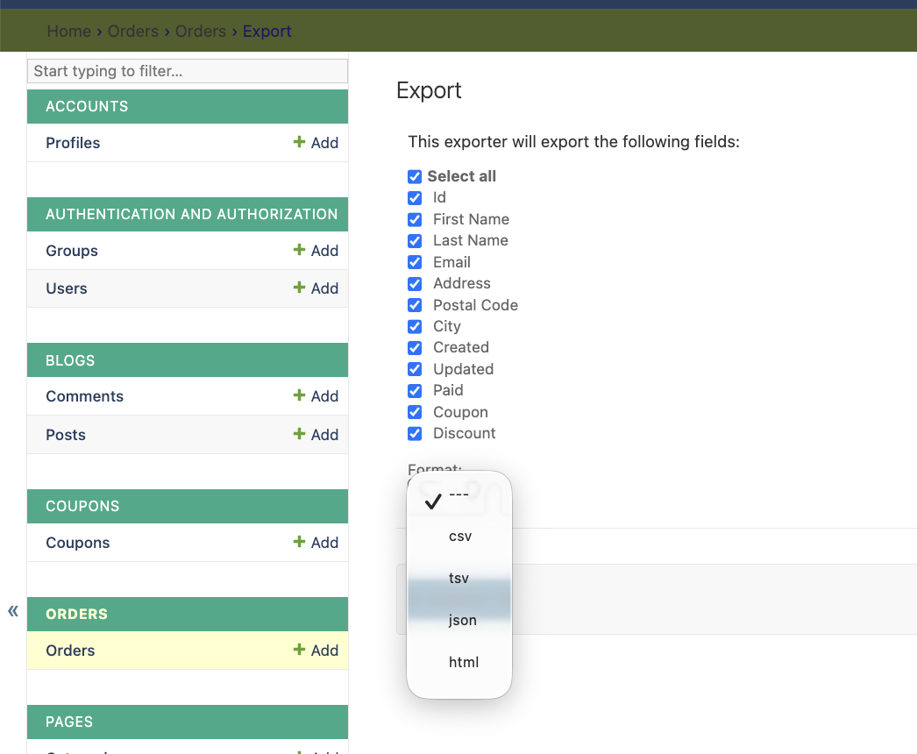
Export dish database to different format

Slide 43
Team Divisions & Reflections
Member | Contribution
Wong Chi Hung | Profile, Post(CRUD), Comment(CRUD) reply comment(CRUD), comment management, overall UI style adjustment, WebSite Testing
Wong Kwok Bun | Project idea
Loo Kin Wah | Coupon function, Pagination, Language, Lightbox, Payment
Ho Chak Kong | Review function, Product Priminary Layout, Issue in Importing Dining Mechainism (Slug in Chinese), Deployment - http://django.natureai.dpdns.org/
Leung Kwun Chiu Jackie | Overall styling, CSS, Content creator, power point

Slide 44
Team Divisions & Reflections
Key Learnings:
user experience testing
Bootstrap framework for responsive design
Source code version control by Git
Cross-browser compatibility challenges
Challenges Overcome:
Source code solve conflict at merge stage
Database design
Apply the django skill proficiency
Learning user authentication
Learning using ORM instead of SQL statement

Slide 45
Jackie Leung’s Reflection
This project taught me how to build an efficient website using CSS, Bootstrap, the Django framework, and GitHub. While the initial learning curve was steep, the reward of mastering these powerful—and freely available—tools made the journey invaluable. Moreover, with the help of AI, I can extend my boundaries beyond my imagination.
The creation of this website meets a modern necessity. As more Hong Kong restaurants increasingly move into unconventional, hard-to-find spaces in old factories, a professional online platform is key to making them discoverable.
Finally, my sincere thanks to my teammates for their proactive collaboration, for maintaining a steady project pace, and for their patient guidance as I found my footing in IT.

